Slide 1




NEXT GEN EMPLOYABILITY PROGRAM
Creating a future-ready workforce
College Name:
Student Name :PON LAVANYA S
Student ID :511321205021
Kingston Engineering College

Slide 2

CAPSTONE PROJECT SHOWCASE
Project Title
Building Bus Reservation System using Python and Django
Abstract | Problem Statement | Project Overview | Proposed Solution | Technology Used | Modelling & Results | Conclusion

Slide 3
Abstract
The bus reservation system is a software application designed to streamline the process of booking and managing bus tickets.
Using Python programming language, this system will allow users to search for available bus routes, select seats, make payments, and receive confirmation of their bookings. The system will also include features such as user authentication, real-time seat availability updates, and booking history tracking. By leveraging Python's versatility and efficiency.
The bus reservation system aims to provide a user-friendly and efficient booking experience for both passengers and bus operators.

Slide 4
Problem Statement
Problem Statement:
The current bus reservation system lacks efficiency and user-friendliness, leading to long waiting times, manual errors, and difficulty in managing bookings.
To address these issues, we aim to develop a bus reservation system using Python that automates the booking process, improves user experience, and provides real-time updates on seat availability.
By leveraging Python's capabilities in data processing, user interface design, and system integration, we seek to create a robust and reliable solution that enhances the overall efficiency and convenience of bus ticket booking for both passengers and bus operators.

Slide 5
Project Overview
Overview:
The bus reservation system project aims to develop a web-based application using Python and Django framework to streamline the process of booking bus tickets.
By leveraging the power of Python for backend logic and Django for frontend development, the system will allow users to search for bus routes, select seats, make payments, and receive booking confirmations.
The project will also include features such as user authentication, real-time seat availability updates, and booking management for bus operators.
Through the use of Python and Django, we aim to create a scalable and user-friendly bus reservation system that enhances the overall booking experience for both passengers and bus companies.

Slide 6
Proposed Solution
.
The bus reservation system will be developed using Python and Django to create a robusts and user-friendly platform for booking bus tickets.
The system will include features such as user authentication, search functionality for bus routes, seat selection, payment processing, and booking confirmation. Utilizing Python for backend logic and Django for frontend development.
Real-time updates on seat availability and booking management tools for bus operators will also be integrated to enhance the overall functionality of the system.
By leveraging the capabilities of Python and Django, we aim to deliver a reliable and scalable bus reservation solution that meets the needs of both passengers and bus companies.

Slide 7

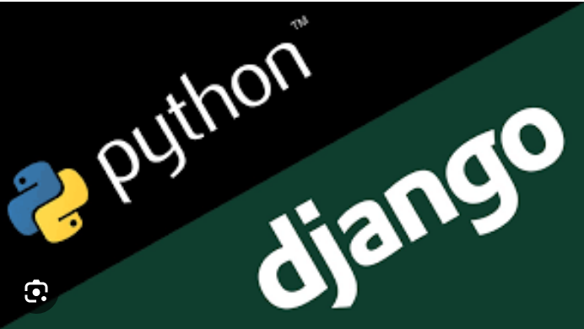
Technology Used
Front-end
Back-end

Slide 8
Modelling & Results
To start, you can create models for buses, routes, seats, bookings, and users using Django's built-in ORM (Object-Relational Mapping) system. Define relationships between these models to represent the data structure of the reservation system accurately.
For example, you can create a Bus model with fields like bus_number and capacity, a Route model with fields like origin and destination, a Seat model with fields like seat_number and availability status, a Booking model with fields like user, bus, route, and seat, and a User model with fields like username and email.
Once you have defined the models, you can use Django's admin interface to populate the database with sample data and test the functionality of the reservation system. You can create views and templates to display bus routes, available seats, and booking forms to users. Implement logic to handle seat selection, payment processing, and booking confirmation.
By following these steps and leveraging the power of Python and Django, you can model and implement a bus reservation system that meets the requirements of your project.

Slide 9
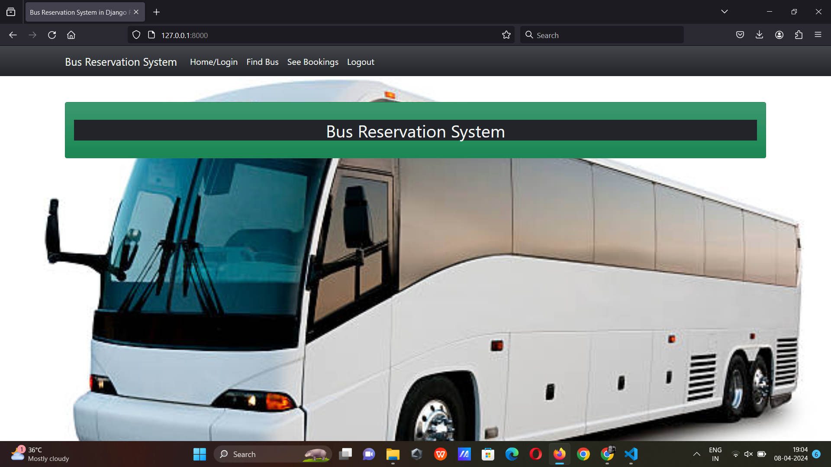
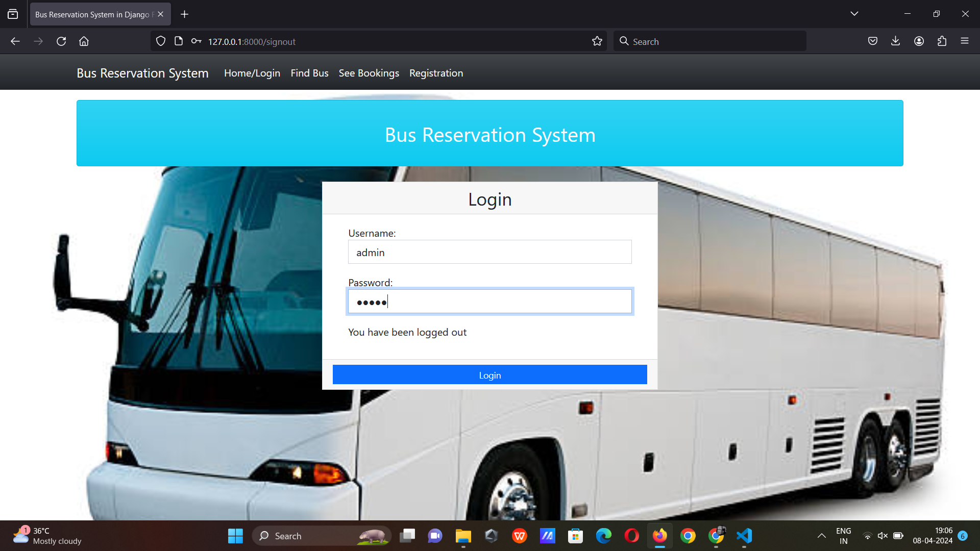
Homepage

Slide 10
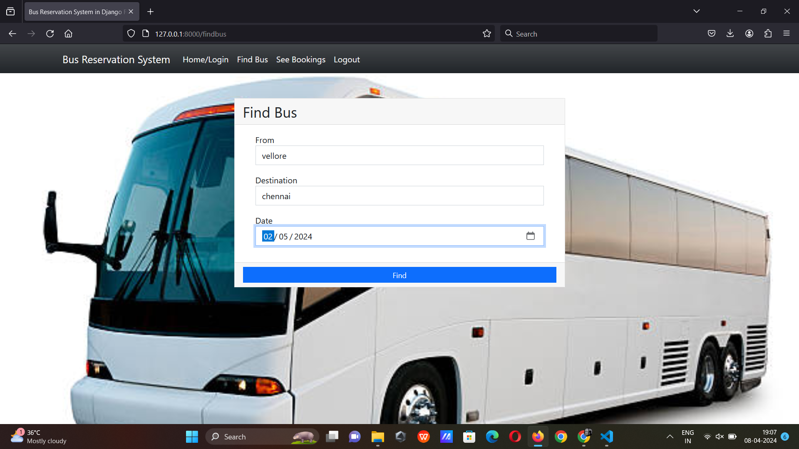
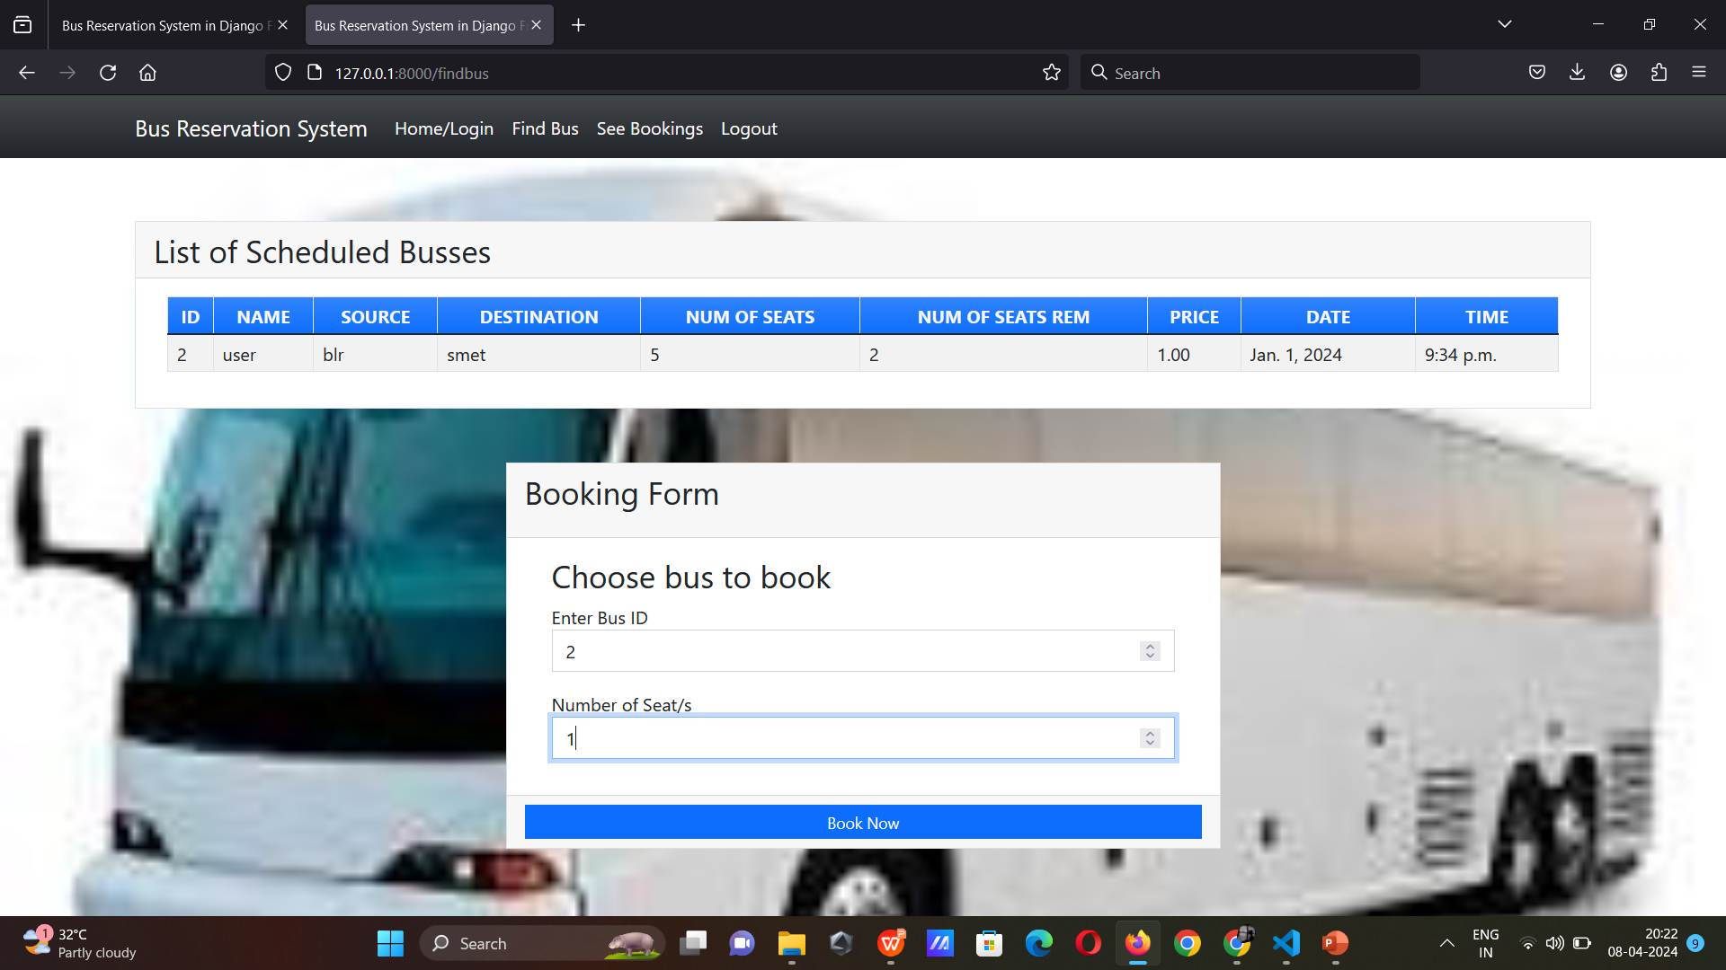
About-Us-Page

Slide 11
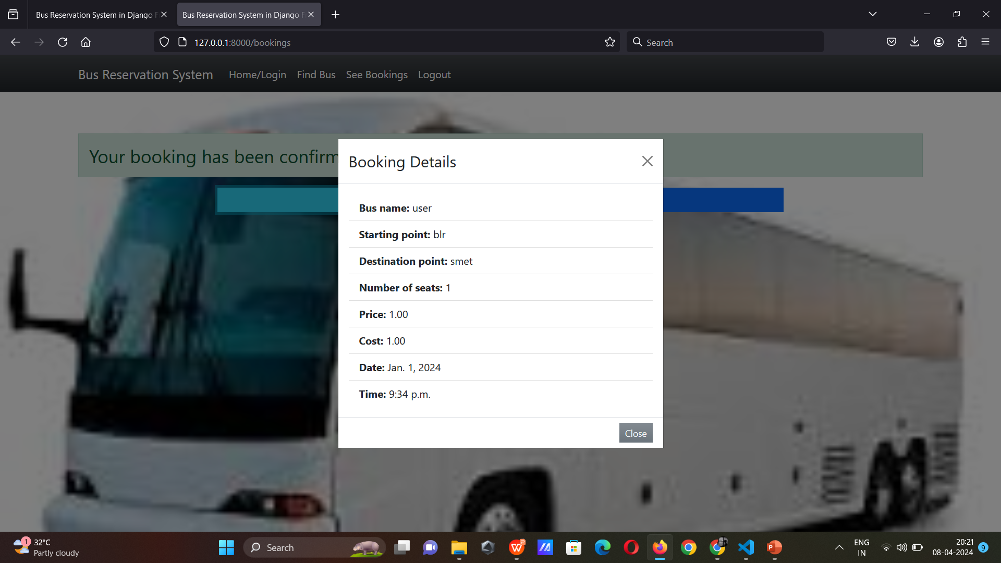
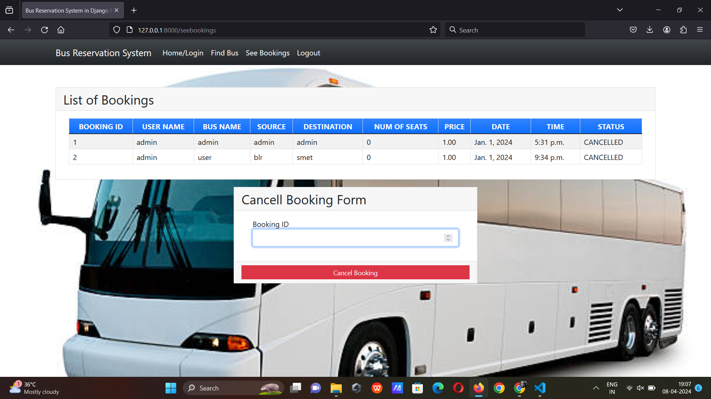
Service-Page

Slide 12
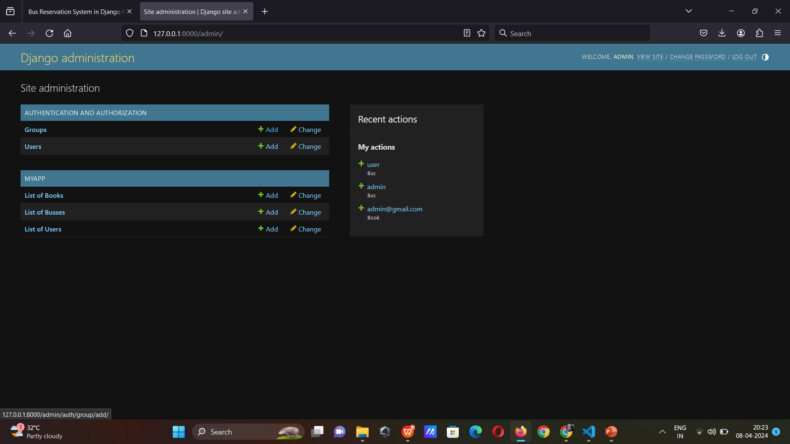
Departments-Page

Slide 13
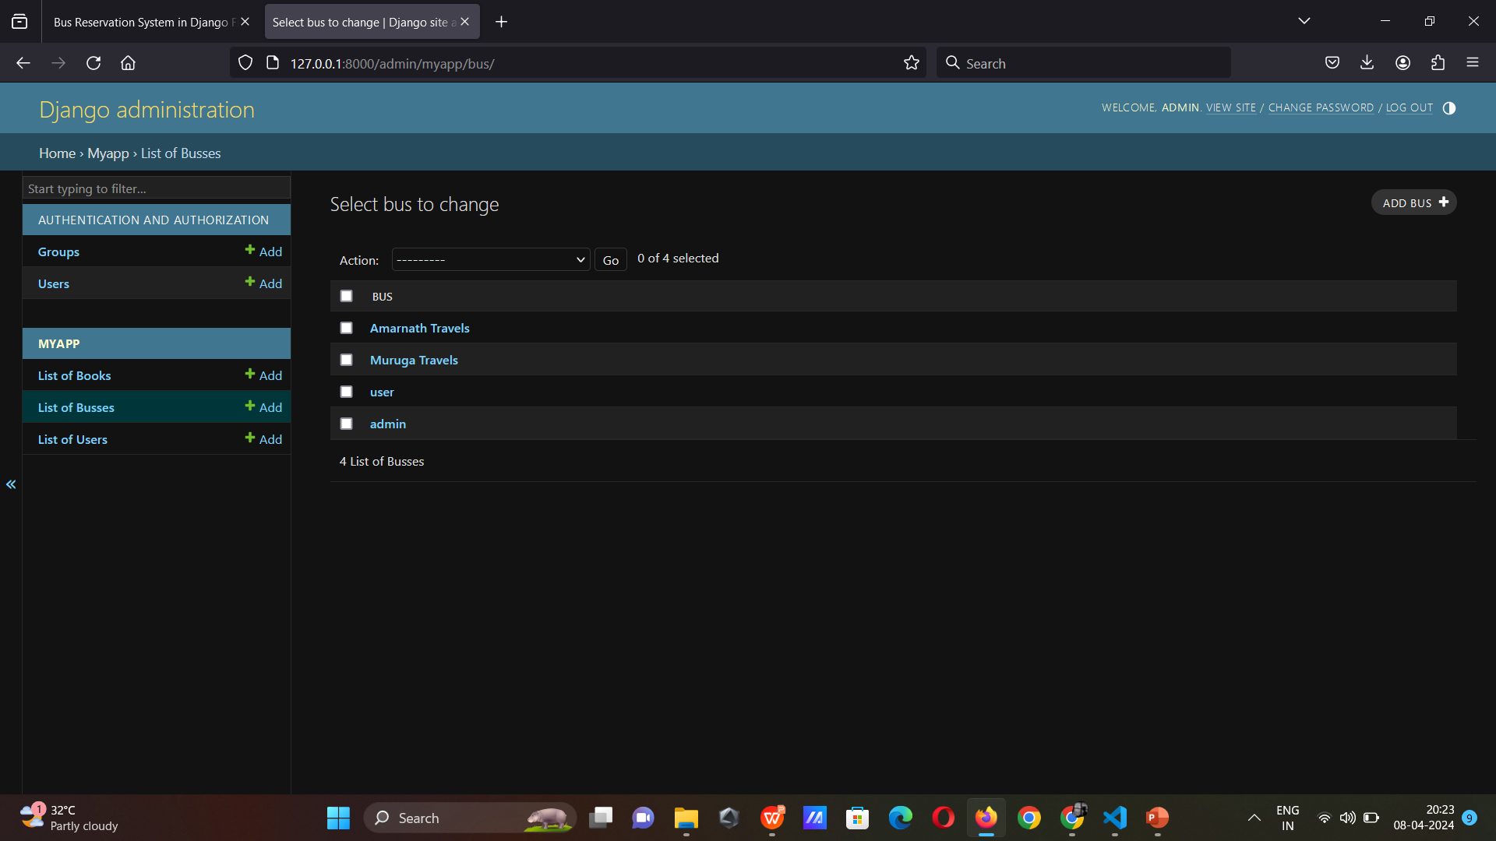
Blog-Page

Slide 14
Future Enhancements:
Real-time tracking: Implementing a real-time tracking feature that allows passengers to track the location of their bus in real-time.
Mobile app integration: Developing a mobile app for the bus reservation system that allows passengers to easily book, cancel, and manage their reservations on-the-go.
Loyalty program: Introducing a loyalty program for frequent bus travelers that offers rewards and discounts for repeat bookings.
Accessibility features: Enhancing the system with accessibility features such as voice commands and screen reader compatibility for passengers with disabilities.
Multi-language support: Adding support for multiple languages to cater to a diverse range of passengers from different regions.

Slide 15
Conclusion
A conclusion on a bus reservation system project using Python and Django. In conclusion, building a bus reservation system using Python and Django can provide a user-friendly and efficient way for customers to book bus tickets online.
By utilizing Django's powerful features for web development and Python's versatility, you can create a robust system that handles reservations, payments, and seat availability seamlessly.
Overall, this project can enhance the user experience and streamline the booking process for both customers and bus operators. If you have any more questions or need further assistance, feel free to ask!

Slide 16
Thank You!
Notes:
Thank You !!

